Slide 1





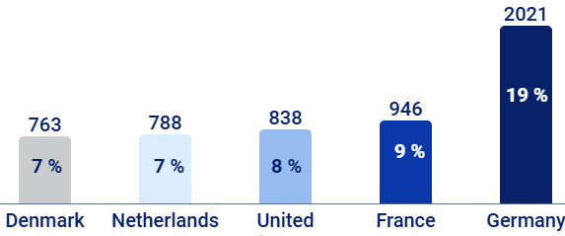
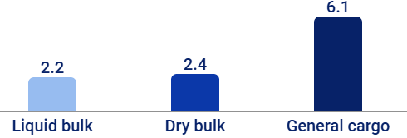
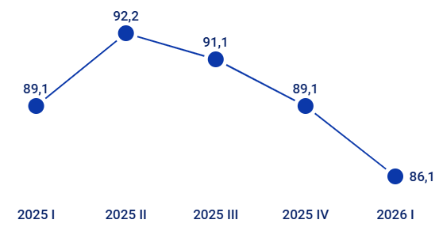

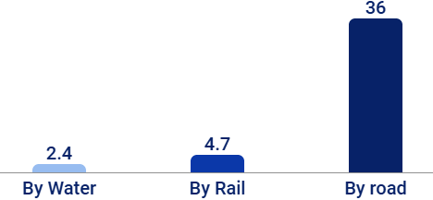

Main transport and logistics market indicators
Revenue
Gross value added
Export of transport services
Transport sector employees
21 bn €
8,0 bn €
11 bn €
152 k or 10 %
6,7 %
5,6 %
5%
of the country workforce
2025 1-12
2025 1-12
2025 1-12
2025 1-12
Main transport export markets M €
The port of Klaipėda handled 11 M T of cargo, an 9 % increase
1,52 M
+19%
+8%
+7%
-13%
LTOU passenger numbers continue to grow
2025 1-12
2026 I Q
2026 I Q
Freight transported: 43 M T, 0 %
Passenger transport by all modes of transport, M
Number of flights
+1%
+12%
-19%
Vilnius
(VNO)
Kaunas
(KUN)
Palanga
(PLQ)
2026 I Q
2026 I Q
Sources: State date, Bank of Lithuania, LOU, KVJUD, LTG

